Slide 1
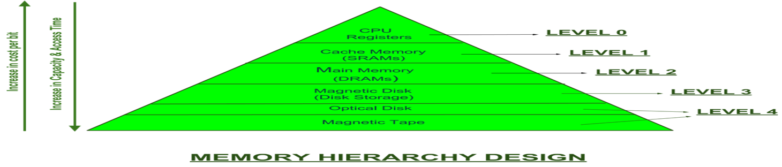
Physical Organization of Parallel Platforms
We begin this discussion with an ideal parallel machine called Parallel Random Access Machine, or PRAM.

Slide 2
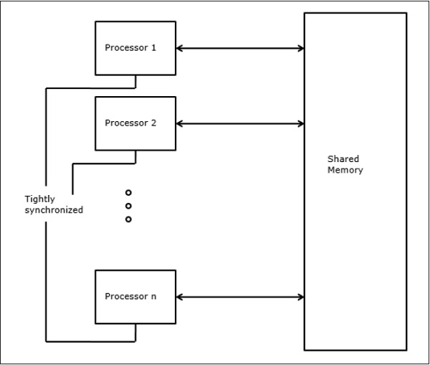
Architecture of an Ideal Parallel Computer
A natural extension of the Random Access Machine (RAM) serial architecture is the Parallel Random Access Machine, or PRAM.
PRAMs consist of p processors and a global memory of unbounded size that is uniformly accessible to all processors.
Processors share a common clock but may execute different instructions in each cycle.

Slide 3
Architecture of an Ideal Parallel Computer
Depending on how simultaneous memory accesses are handled, PRAMs can be divided into four subclasses.
Exclusive-read, exclusive-write (EREW) PRAM.
Concurrent-read, exclusive-write (CREW) PRAM.
Exclusive-read, concurrent-write (ERCW) PRAM.
Concurrent-read, concurrent-write (CRCW) PRAM.

Slide 4
Architecture of an Ideal Parallel Computer
What does concurrent write mean, anyway?
Common: write only if all values are identical.
Arbitrary: write the data from a randomly selected processor.
Priority: follow a predetermined priority order.
Sum: Write the sum of all data items.

Slide 5
Physical Complexity of an Ideal Parallel Computer
Processors and memories are connected via switches.
Since these switches must operate in O(1) time at the level of words, for a system of p processors and m words, the switch complexity is O(mp).
Clearly, for meaningful values of p and m, a true PRAM is not realizable.

Slide 6
Interconnection Networks for Parallel Computers
Interconnection networks carry data between processors and to memory.
Interconnects are made of switches and links (wires, fiber).
Interconnects are classified as static or dynamic.
Static networks consist of point-to-point communication links among processing nodes and are also referred to as direct networks.
Dynamic networks are built using switches and communication links. Dynamic networks are also referred to as indirect networks.

Slide 7







Static and Dynamic Interconnection Networks
Static network
Indirect network
P
P
P
P
P
P
P
P
Network interface/switch
Processing node
Switching element
Classification of interconnection networks: (a) a static network; and (b) a dynamic network.

Slide 8
Interconnection Networks
Switches map a fixed number of inputs to outputs.
The total number of ports on a switch is the degree of the switch.
The cost of a switch grows as the square of the degree of the switch, the peripheral hardware linearly as the degree, and the packaging costs linearly as the number of pins.

Slide 9
Interconnection Networks: Network Interfaces
Processors talk to the network via a network interface.
The network interface may hang off the I/O bus or the memory bus.
In a physical sense, this distinguishes a cluster from a tightly coupled multicomputer.
The relative speeds of the I/O and memory buses impact the performance of the network.

Slide 10
Network Topologies
A variety of network topologies have been proposed and implemented.
These topologies tradeoff performance for cost.
Commercial machines often implement hybrids of multiple topologies for reasons of packaging, cost, and available components.

Slide 11
Network Topologies: Buses
Some of the simplest and earliest parallel machines used buses.
All processors access a common bus for exchanging data.
The distance between any two nodes is O(1) in a bus. The bus also provides a convenient broadcast media.
However, the bandwidth of the shared bottleneck.
bus is a major
Typical bus based machines are limited to dozens of nodes. Sun Enterprise servers and Intel Pentium based shared-bus multiprocessors are examples of such architectures.

Slide 12
Network Topologies: Buses
Shared Memory
Address
Data
Processor 0
Processor 1
(a)
Shared Memory
Address
Data
Cache / Local Memory
Cache / Local Memory
Processor 0
Processor 1
(b)
Bus-based interconnects (a) with no local caches; (b) with local
memory/caches.
Since much of the data accessed by processors is local to the processor, a local memory can improve the performance of bus- based machines.

Slide 13

Network Topologies: Crossbars
A crossbar network uses an p × m grid of switches to connect p
inputs to m outputs in a non-blocking manner.
Memory Banks
0 1 2 3 4 5 b−1
A switching element
0
1
2
3
4
5
6
Processing Elements
p−1
A completely non-blocking crossbar network connecting p
processors to b memory banks.

Slide 14
Network Topologies: Crossbars
The cost of a crossbar of p processors grows as O(p²).
This is generally difficult to scale for large values of p.
Examples of machines that employ crossbars include the Sun Ultra HPC 10000 and the Fujitsu VPP500.

Slide 15
Network Topologies: Multistage Networks
Crossbars have excellent performance scalability but poor cost scalability.
Buses have excellent cost scalability, but poor performance scalability.
Multistage interconnects strike a compromise between these extremes.

Slide 16
Network Topologies: Multistage Networks
Processors
Multistage interconnection network
Memory banks
 |  |  | Stage 1 |  | Stage 2 |  |  | Stage n
0 |  |  |  |  |  |  |  |  |  |  | 0
1 |  |  |  |  |  |  |  |  |  |  | 1
 |  | . . . . .
 |  |  |  | . . . . . |  | . . . . . . . . . . . . . . . . . . . . . . . . .
p-1 |  |  |  |  |  |  |  |  |  |  | b-1
.
.
.
.
.
The schematic of a typical multistage interconnection network.

Slide 17
Network Topologies: Multistage Omega Network
One of the most commonly used multistage interconnects is the Omega network.
This network consists of log p stages, where p is the number of inputs/outputs.
At each stage, input i is connected to output j if:
2i, 0 ≤ i ≤ p/2 − 1 2i + 1 − p, p/2 ≤ i ≤ p − 1
j =

Slide 18
Network Topologies: Multistage Omega Network
Each stage of the Omega network implements a perfect
shuffle as follows:
 | 000 | 0 | 0 | 000 = left_rotate(000)
 | 001 | 1 | 1 | 001 = left_rotate(100)
 | 010 | 2 | 2 | 010 = left_rotate(001)
 | 011 | 3 | 3 | 011 = left_rotate(101)
 | 100 | 4 | 4 | 100 = left_rotate(010)
 | 101 | 5 | 5 | 101 = left_rotate(110)
 | 110 | 6 | 6 | 110 = left_rotate(011)
 | 111 | 7 | 7 | 111 = left_rotate(111)
A perfect shuffle interconnection for eight inputs and outputs.

Slide 19
Network Topologies: Multistage Omega Network
The perfect shuffle patterns are connected using 2 × 2 switches.
The switches operate in two modes – crossover or passthrough.
(a)
(b)
Two switching configurations of the 2 × 2 switch: (a) Pass-through;
(b) Cross-over.

Slide 20
Network Topologies: Multistage Omega Network
A complete Omega network with the perfect shuffle interconnects and switches can now be illustrated:
000
001
000
001
010
011
010
011
100
101
100
101
110
111
110
111
A complete omega network connecting eight inputs and eight outputs.
An omega network has p/2 × log p switching nodes, and the cost of such a network grows as Θ(p log p).

Slide 21
Network Topologies: Multistage Omega Network – Routing
Let s be the binary representation of the source and d be that of the destination processor.
The data traverses the link to the first switching node. If the most significant bits of s and t are the same, then the data is routed in pass-through mode by the switch else, it switches to crossover.
This process is repeated for each of the log p switching stages.
Note that this is not a non-blocking switch.

Slide 22
Network Topologies: Multistage Omega Network – Routing
000
001
000
001
010
011
B
010
011
100
101
100
101
A
110
111
110
111
An example of blocking in omega network: one of the messages (010 to 111 or 110 to 100) is blocked at link AB.

Slide 23
Network Topologies: Completely Connected Network
Each processor is connected to every other processor.
The number of links in the network scales as O(p²).
While the performance scales very well, the hardware complexity is not realizable for large values of p.
In this sense, these networks are static counterparts of crossbars.

Slide 24
Network Topologies: Completely Connected and Star Connected Networks
Example of an 8-node completely connected network.
(a) (b)
(a) A completely-connected network of eight nodes; (b) a Star connected network of nine nodes.

Slide 25
Network Topologies: Star Connected Network
Every node is connected only to a common node at the center.
Distance between any pair of nodes is O(1).
However, the
central node becomes a bottleneck.
In this sense, star connected networks are static counterparts of buses.

Slide 26
Network Topologies: Linear Arrays, Meshes, and k-d
Meshes
In a linear array, each node has two neighbors, one to its left and one to its right. If the nodes at either end are connected, we refer to it as a 1-D torus or a ring.
A generalization to 2 dimensions has nodes with 4 neighbors, to the north, south, east, and west.
A further generalization to d dimensions has nodes with 2d
neighbors.
A special case of a d-dimensional mesh is a hypercube. Here,
d = log p, where p is the total number of nodes.

Slide 27




Network Topologies: Linear Arrays
(a) (b)
Linear arrays: (a) with no wraparound links; (b) with wraparound
link.

Slide 28
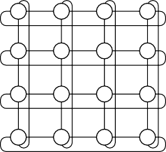
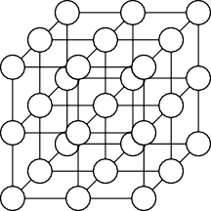
Network Topologies: Two- and Three Dimensional Meshes
(a) (b) (c)
Two and three dimensional meshes: (a) 2-D mesh with no wraparound; (b) 2-D mesh with wraparound link (2-D torus); and
(c) a 3-D mesh with no wraparound.

Slide 29












Network Topologies: Hypercubes and their Construction
100
110
0
00
10
000
010
101
111
1
01
11
001
011
0-D hypercube
1-D hypercube
2-D hypercube
3-D hypercube
0100
0110
1100
1110
0000
0010
1010
1000
0101
0111
1101
1111
0001
0011
1001
1011
4-D hypercube
Construction of hypercubes from hypercubes of lower
dimension.

Slide 30
Network Topologies: Properties of Hypercubes
The distance between any two nodes is at most log p.
Each node has log p neighbors.
The distance between two nodes is given by the number of bit positions at which the two nodes differ.

Slide 31
Network Topologies: Tree-Based Networks
Processing nodes
Switching nodes
(b)
Complete binary tree networks: (a) a static tree network; and
a dynamic tree network.

Slide 32
Network Topologies: Tree Properties
The distance between any two nodes is no more than 2 log p.
Links higher up the tree potentially carry more traffic than those at the lower levels.
For this reason, a variant called a fat-tree, fattens the links as we go up the tree.
Trees can be laid out in 2D with no wire crossings.
This is an
attractive property of trees.

Slide 33
Network Topologies: Fat Trees
A fat tree network of 16 processing nodes.

Slide 34
Evaluating Static Interconnection Networks
Diameter: The distance between the farthest two nodes in the network. The diameter of a linear array is p − 1, that of a mesh is 2(√p − 1), that of a tree and hypercube is log p, and that of a completely connected network is O(1).
Bisection Width: The minimum number of wires you must cut to divide the network into two equal parts. The bisection width of a linear array and tree is 1, that of a mesh is √p, that of a hypercube is p/2 and that of a completely connected network is p²/4.
Cost: The number of links or switches (whichever is asymptotically higher) is a meaningful measure of the cost. However, a number of other factors, such as the ability to lay out the network, the length of wires, etc., also factor in to the cost.

Slide 35
Evaluating Static Interconnection Networks
Network | Diameter | Bisection Width | Arc Connectivity | Cost (No. of links)
Completely-connected Star | 1 | p²/4 | p − 1 | p(p − 1)/2
2 1
2 log((p + 1)/2) 1
1
1
1
2
4
log p
2d
p − 1
Complete binary tree Linear array
2-D mesh, no wraparound
2-D wraparound mesh Hypercube
Wraparound k-ary d-cube
p − 1
p − 1
√_{p}
2√p
p/2 _{2k}d−1
√
1
p − 1
2( p − 1)
2(p − √p)
2[√p/2♩
2p
(p log p)/2
dp
log p d[k/2♩

Slide 36
Evaluating Dynamic Interconnection Networks
1pt Network | Diameter | Bisection Width | Arc Connectivity | Cost (No. of links)
Crossbar | 1 | p | 1 | _{p}2
Omega Network | log p | p/2 | 2 | p/2
Dynamic Tree | 2 log p | 1 | 2 | p − 1

Slide 37
Cache Coherence in Multiprocessor Systems
Interconnects provide basic mechanisms for data transfer.
In the case of shared address space machines, additional hardware is required to coordinate access to data that might have multiple copies in the network.
The underlying technique must provide some guarantees on the semantics.
This guarantee is generally one of serializability, i.e., there exists some serial order of instruction execution that corresponds to the parallel schedule.

Slide 38
Cache Coherence in Multiprocessor Systems
When the value of a variable is changes, all its copies must either be invalidated or updated.
P0
load x
P1
load x
P0
write #3, x
P1
x = 1
x = 1
x = 3
x = 1
x = 1
x = 1
Memory
Invalidate
Memory
P0
load x
P1
load x
(a)
P0
write #3, x
P1
x = 1
x = 1
x = 3
x = 3
x = 1
x = 3
Update
Memory Memory
(b)
Cache coherence in multiprocessor systems: (a) Invalidate protocol; (b) Update protocol for shared variables.

Slide 39
Cache Coherence: Update and Invalidate Protocols
If a processor just reads a value once and does not need it again, an update protocol may generate significant overhead.
If two processors make interleaved test and updates to a variable, an update protocol is better.
Both protocols suffer from false sharing overheads (two words that are not shared, however, they lie on the same cache line).
Most current machines use invalidate protocols.

Slide 40
Maintaining Coherence Using Invalidate Protocols
Each copy of a data item is associated with a state.
One example of such a set of states is, shared, invalid, or dirty.
In shared state, there are multiple valid copies of the data item (and therefore, an invalidate would have to be generated on an update).
In dirty state, only one copy exists and therefore, no invalidates need to be generated.
In invalid state, the data copy is invalid, therefore, a read generates a data request (and associated state changes).

Slide 41
Maintaining Coherence Using Invalidate Protocols
read
Shared
read
write
C_read
C_write
Invalid
write
Dirty
read/write
C_write
flush
State diagram of a simple three-state coherence protocol.

Slide 42
Maintaining Coherence Using Invalidate Protocols
Time
Instruction at Processor 0 | Instruction at Processor 1 | Variables and their states at Processor 0 | Variables and their states at Processor 1 | Variables and their states in Global mem.
 |  |  |  | x = 5, D y = 12, D
read x | read y | x = 5, S | y = 12, S | x = 5, S y = 12, S
x = x + 1 | y = y + 1 | x = 6, D | y = 13, D | x = 5, I y = 12, I
read y | read x | y = 13, S x = 6, S | y = 13, S x = 6, S | y = 13, S x = 6, S
x = x + y | y = x + y | x = 19, D y = 13, I | x = 6, I y = 19, D | x = 6, I y = 13, I
x = x + 1 | y = y + 1 | x = 20, D | y = 20, D | x = 6, I y = 13, I
Example of parallel program execution with the simple three-state coherence protocol.

Slide 43
Snoopy Cache Systems
How are invalidates sent to the right processors?
In snoopy caches, there is a broadcast media that listens to all invalidates and read requests and performs appropriate coherence operations locally.
Processor
Processor
Processor
Snoop H/W
Cache
Snoop H/W
Cache
Snoop H/W
Cache
Tags
Tags
Tags
Dirty
Address/data
Memory
A simple snoopy bus based cache coherence system.

Slide 44
Performance of Snoopy Caches
Once copies of data are tagged dirty, all subsequent operations can be performed locally on the cache without generating external traffic.
If a data item is read by a number of processors, it transitions to the shared state in the cache and all subsequent read operations become local.
If processors read and update data at the same time, they generate coherence requests on the bus – which is ultimately bandwidth limited.

Slide 45
Directory Based Systems
In snoopy caches, each coherence operation is sent to all processors. This is an inherent limitation.
Why not send coherence requests to only those processors that need to be notified?
This is done using a directory, which maintains a presence vector for each data item (cache line) along with its global state.

Slide 46
Directory Based Systems
Processor
Processor |  |  |  | Interconnection Network
Cache
Memory |  | Presence bits / State
Processor
Cache
Memory |  | Presence bits / State
Cache
Processor
Cache
Interconnection Network
Presence
Data
Processor
Bits
Cache
State
Directory
(a)
(b)
Architecture of typical directory based systems: (a) a centralized directory; and (b) a distributed directory.

Slide 47
Performance of Directory Based Schemes
The need for a broadcast media is replaced by the directory.
The additional bits to store the directory may add significant overhead.
The underlying network must be able to carry all the coherence requests.
The directory is a point of contention, therefore, distributed directory schemes must be used.

